Slide 1
RED CARD CONNECT
MOBILE APP DEVELOPMENT
SITEMAP & LAYOUT
ROUND 3: 17 SEPTEMBER 2014

Slide 2
BRIEF
To design an app that would facilitate Red Card Connect various platforms: TV, Radio, Digital & Social
Key Functions
For public to access the content easily and also be able to customize to fit their preference in terms of news, medium or how any information is shared
Push notifications to initiate content to public; allow for an Alert Notifications (for people who have choose which fav/ bookmark i.e 6pm alert to listen to drivetime or 8pm fightclub etc)
App to socially integrate with our social media platforms (i.e FB, Twitter, etc) for easy likes, comments, share
Live Streaming of DRIVETIME & other shows (might be TV)

Slide 3

LANDING PAGE
RED CARD CONNECT
HELLO
Login with Facebook
Login with Twitter
Login with Email
Create New Account

Slide 4
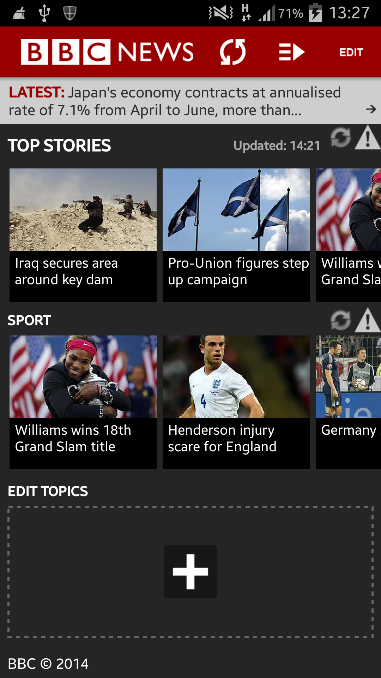
HOME
Content per channels can slide horizontally
<upon clicking, the tab opens/ enlarged vertically>
RED CARD CONNECT
RED CARD CONNECT
RED CARD CONNECT
FEATURES
FEATURES
FEATURES
#onRADIO
#onRADIO
#onRADIO
#onTV
#onTV
#onTV
>
#onDIGITAL
#onDIGITAL
#onDIGITAL
#onSOCIAL
#onSOCIAL
#onSOCIAL
Listen LIVE
Call 6281 1898
Listen LIVE
Call 6281 1898
Listen LIVE
Call 6281 1898

Slide 6
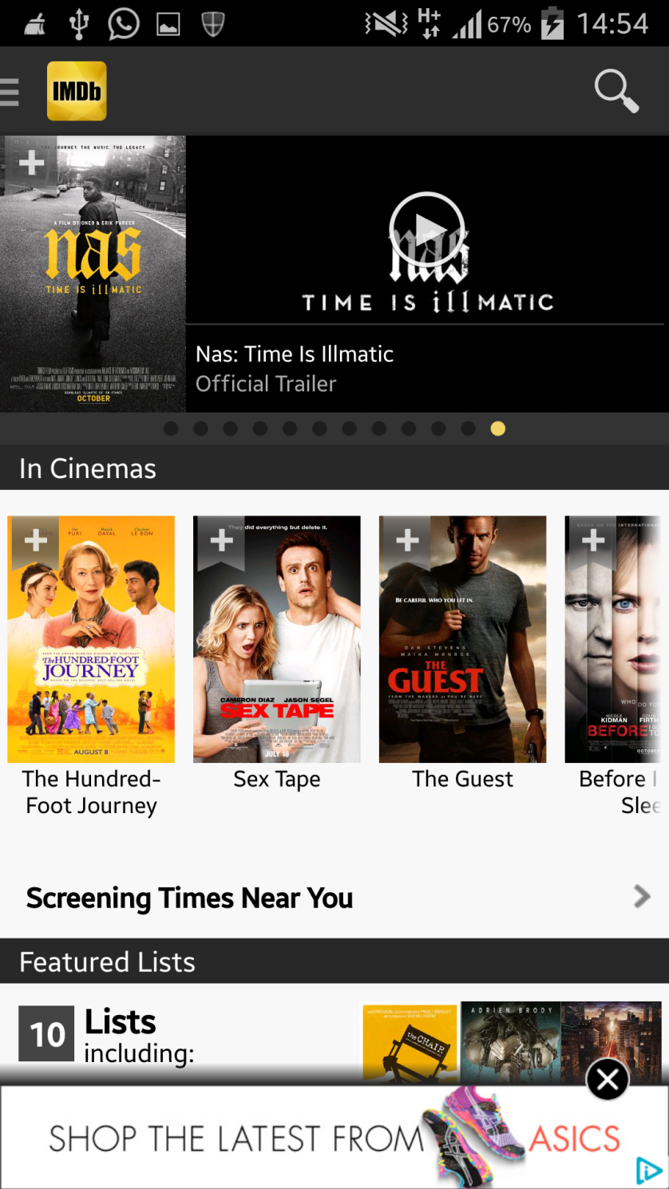
HOME (samples)

Slide 8

MENU
RED CARD CONNECT
FEATURES
HOME
#onRADIO
#onRADIO
#onTV
#onTV
#onDIGITAL
#onSOCIAL
MY LIST +
#onDIGITAL
#onSOCIAL
Listen LIVE
Call 6281 1898

Slide 9
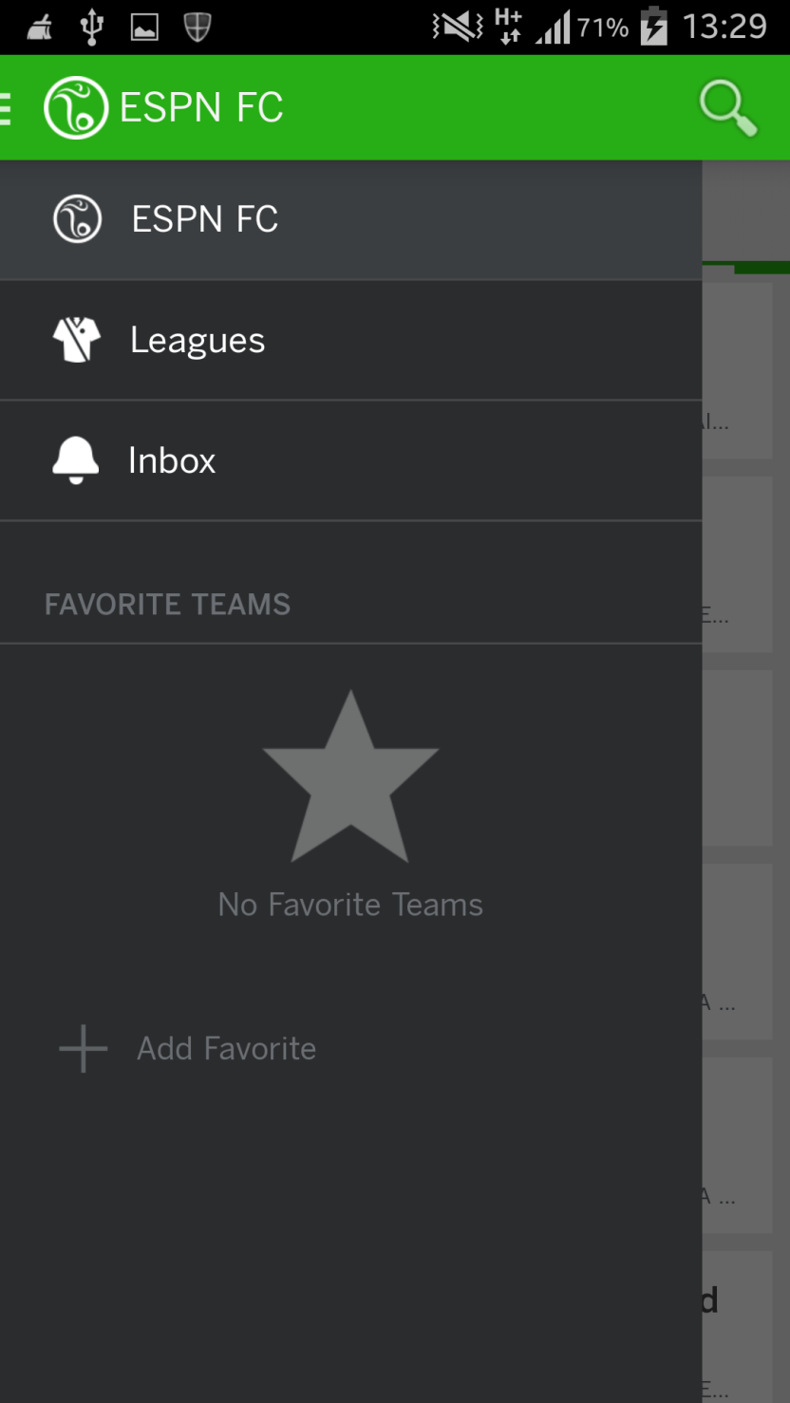
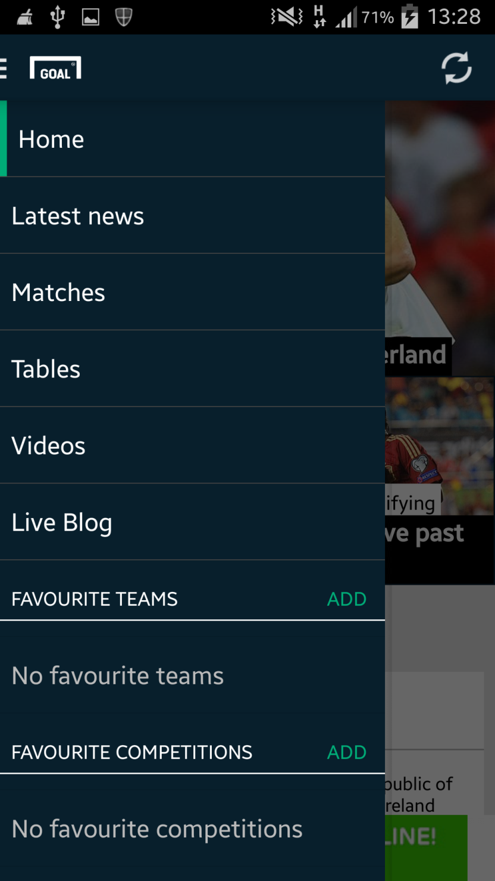
MENU (samples)

Slide 10
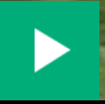
#ONTV
RED CARD CONNECT
FEATURED VIDEO
Filter: Sort by
DATE / SHOWS / MOST POPULAR
Upon clicking on the video, it will go to full screen mode.
#onTV
Each Row is a Playlist from Shows
i.e Trending
Up to 5 of the latest videos that can be swiped horizontal
<
>

Slide 11
#ONRADIO
RED CARD CONNECT
FEATURED AUDIO
Filter: Sort by
DATE / SHOWS / MOST POPULAR / SCHEDULE
Upon clicking on the audio, it will go to full screen mode.
#onRADIO
Each Row is a Playlist from Shows
i.e DRIVETIME
Up to 5 of the latest audios that can be swiped horizontal
<
>

Slide 12
#ONRADIO
RED CARD CONNECT
Sort by Schedule
MON TUE WED THUR FRI SAT SUN
1pm
2pm
3pm
4pm
5pm
6pm
7pm
8pm
9pm
10pm
11pm
Drivetime
Filter: Sort by
DATE / SHOWS / MOST POPULAR / SCHEDULE
Upon clicking on the audio, it will go to full screen mode.
#onRADIO
Each Row is a Playlist from Shows
i.e DRIVETIME
Up to 5 of the latest audios that can be swiped horizontal
<
>
Listen LIVE
Call 6281 1898

Slide 13
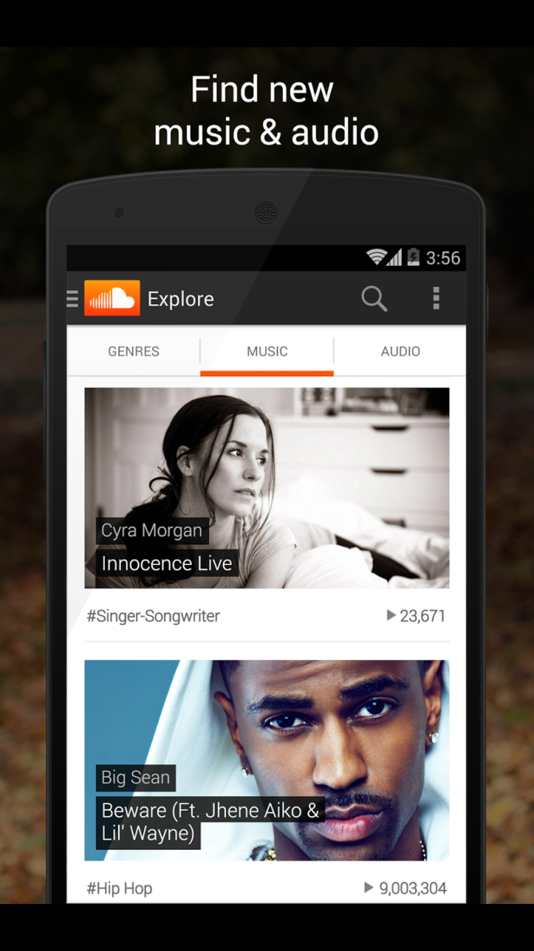
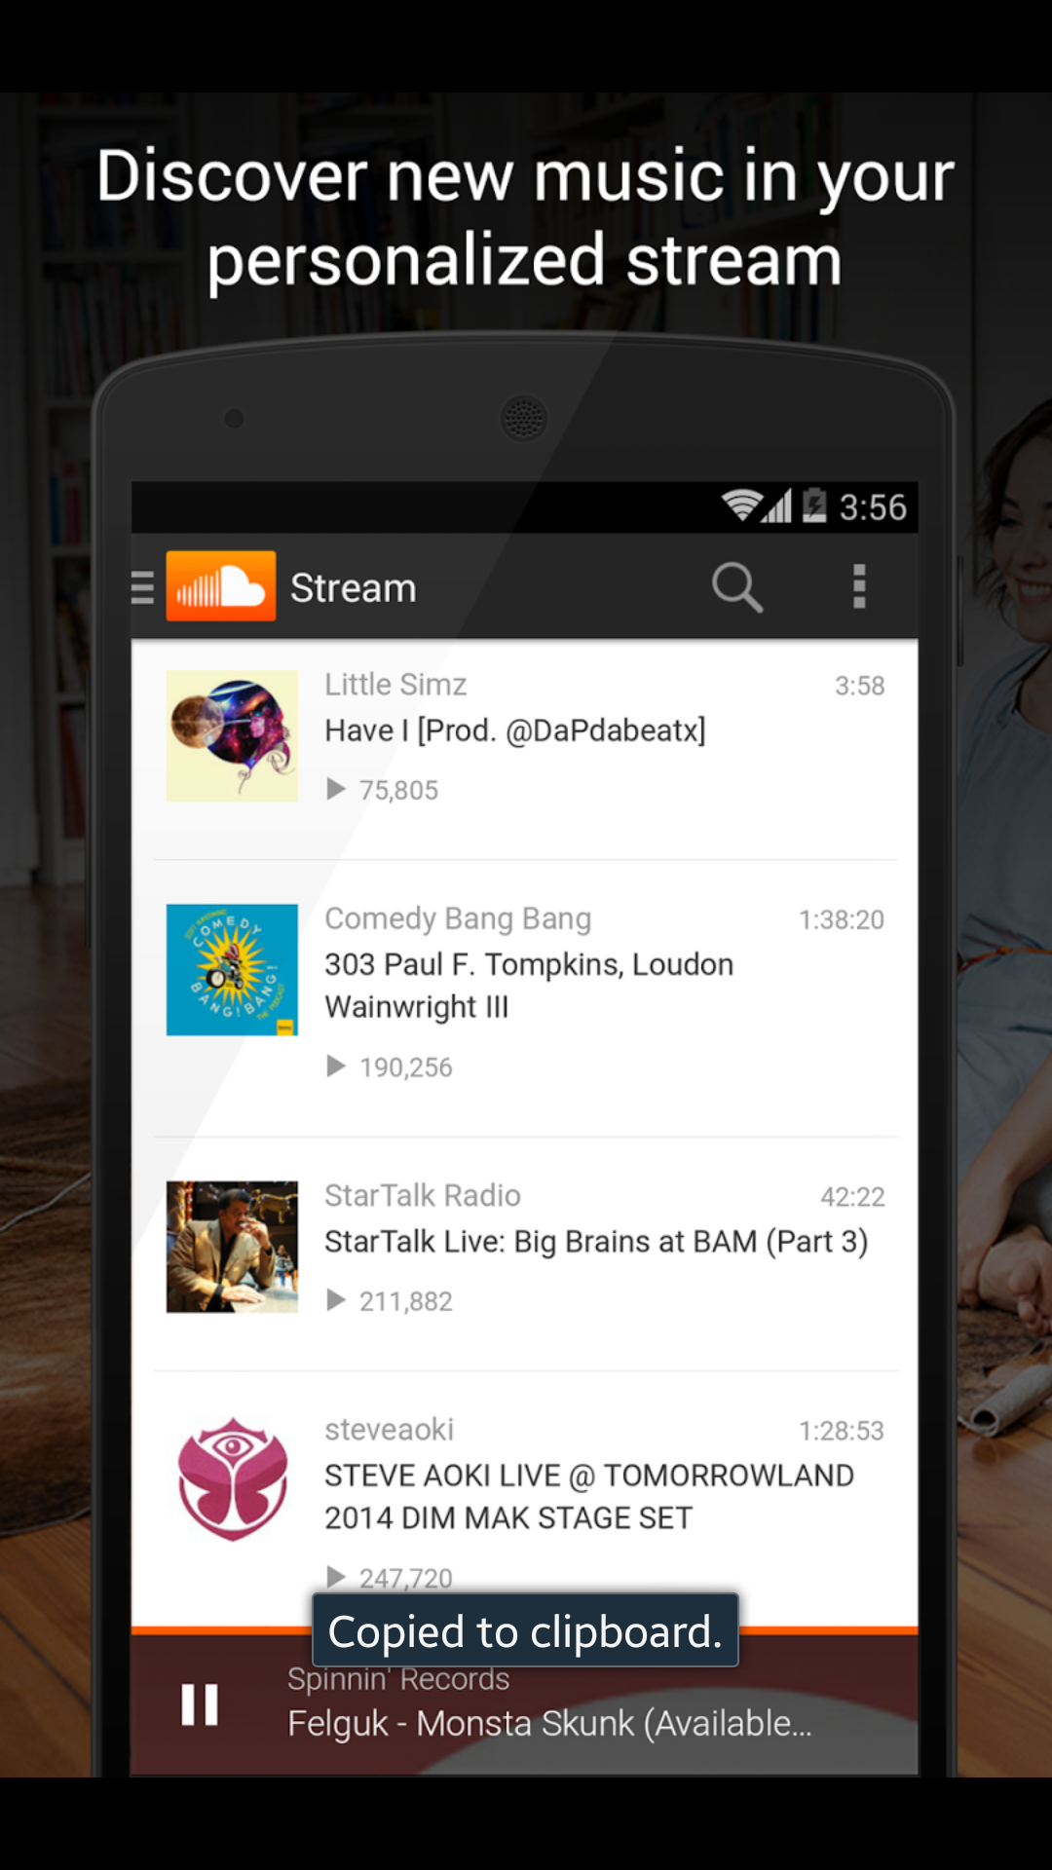
#ONRADIO/ TV (samples)

Slide 14
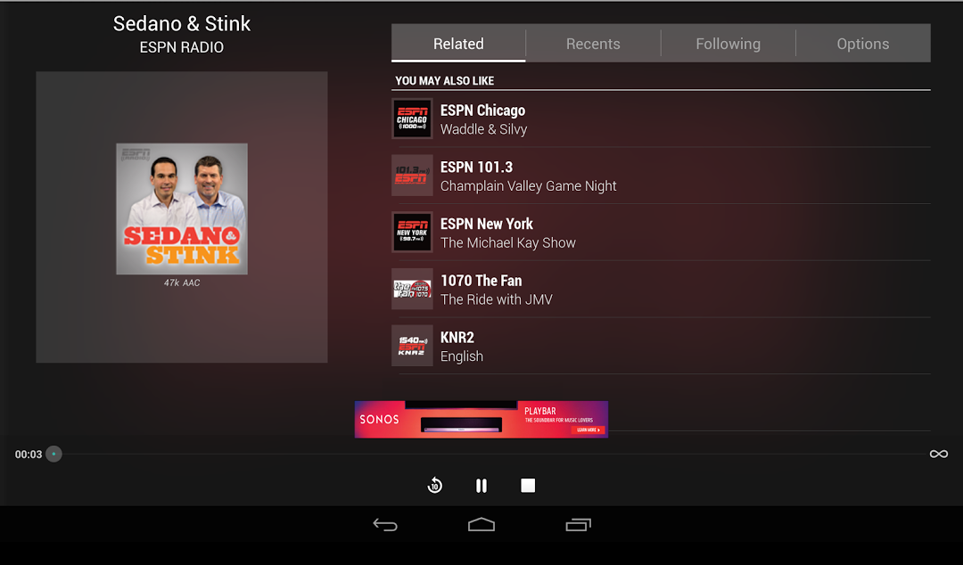
#ONRADIO/ TV (samples)

Slide 15
#ONDIGITAL
RED CARD CONNECT
FEATURED ARTICLES
<
>
Filter: Sort by
DATE / REGION / MOST POPULAR
#onDIGITAL
Each Row is a Category from the Website
i.e Exclusives, Opinion, In the Week
Up to 5 of the latest articles that can be swiped horizontal
<
>

Slide 16
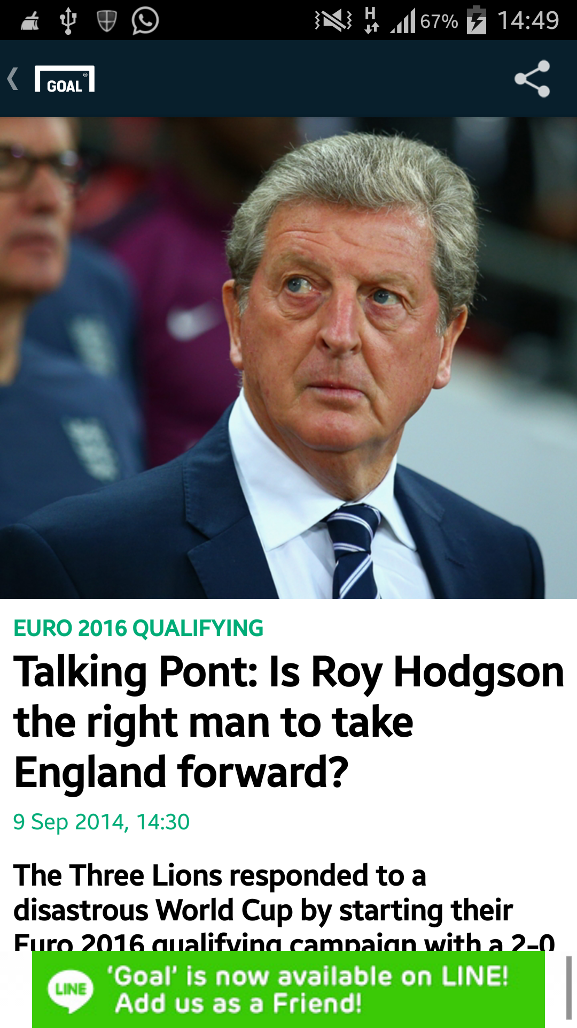
#ONDIGITAL
RED CARD CONNECT
SAMPLE
Layout
Upon clicking on the article
HEADLINE
PICTURE
CAPTION
SOCIAL MEDIA LINKS (SHARE)
BYLINE/ DATE
ARTICLE
#onDIGITAL
<
>

Slide 17
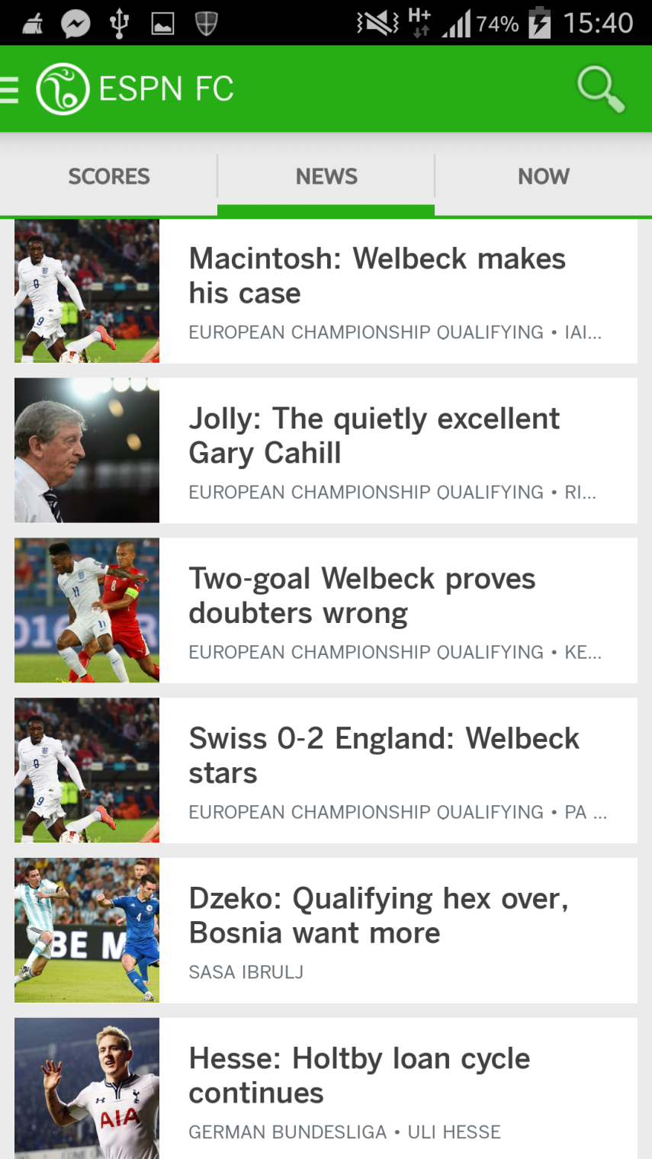
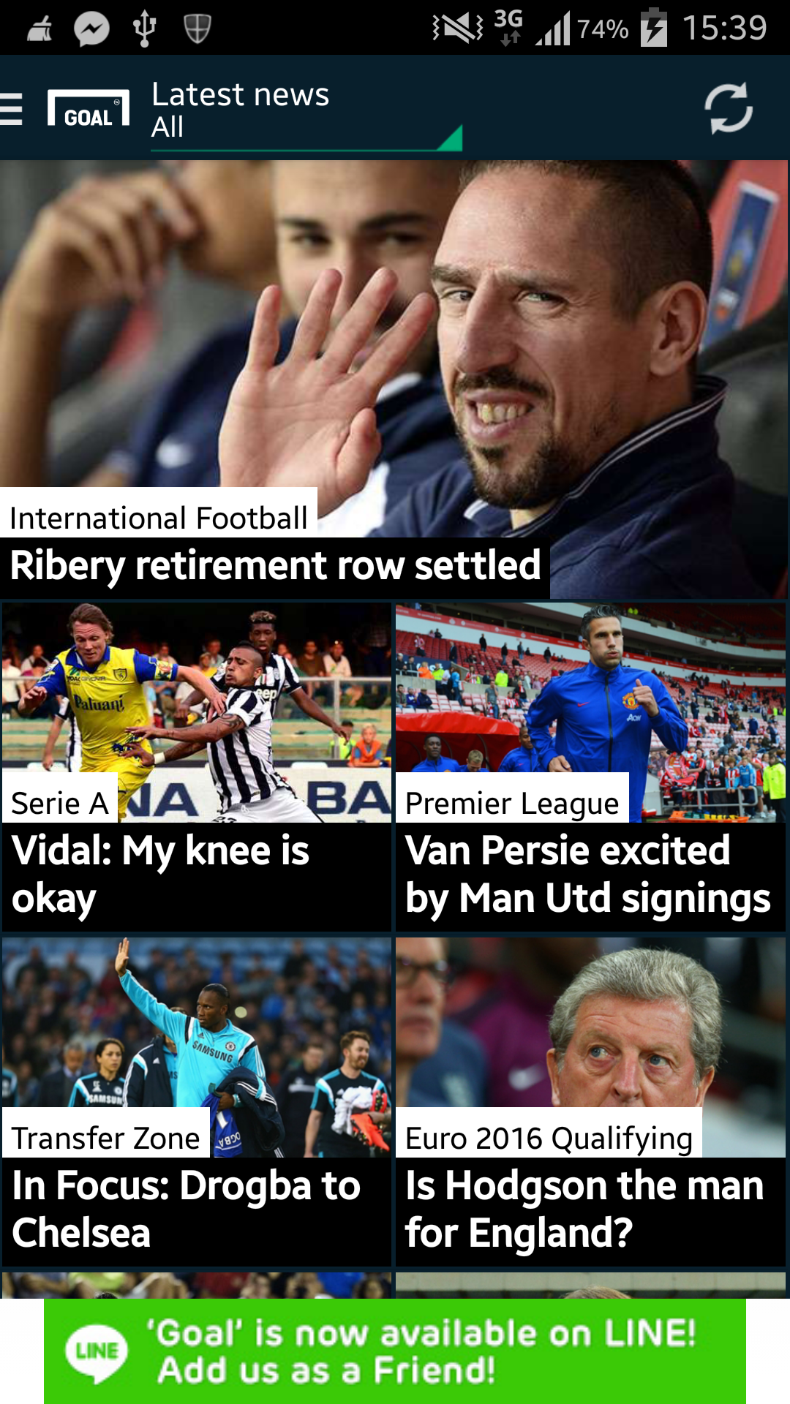
#ONDIGITAL (samples)

Slide 18
#
#ONSOCIAL
RED CARD CONNECT
TRENDING
#
<
>
Filter: Sort by
DATE / MOST POPULAR
Links to all our social media platforms
#onSOCIAL
Each Row is featured content feed from the various social Platform – FB, Instagram, Twitter, Vine
Up to 5 of the latest articles that can be swiped horizontal
<
>

Slide 19
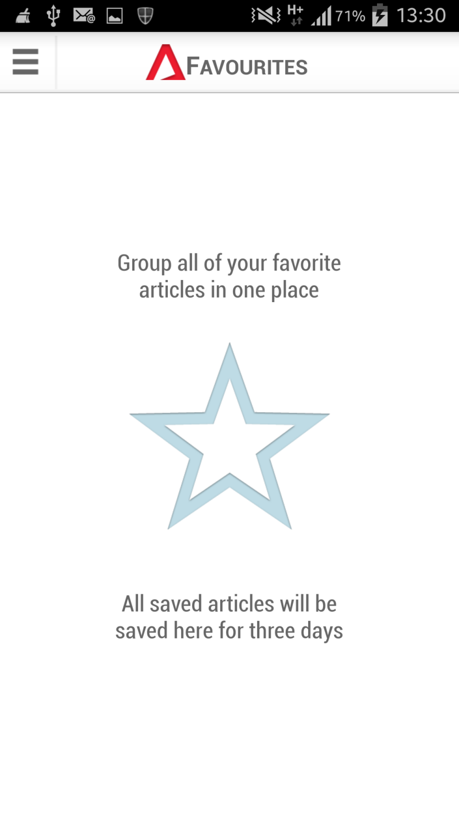
#
MY LIST
RED CARD CONNECT
Customise Content
My List
SAMPLE
+
+
+
+

Slide 20
#
SETTINGS
RED CARD CONNECT
Set Preference
*refer to the ST app for similar settings
SETTINGS
Push Notifications On Off
Alert Notifications On Off
Font Options
Video Options
My List Layout
Social Media Link

Slide 21
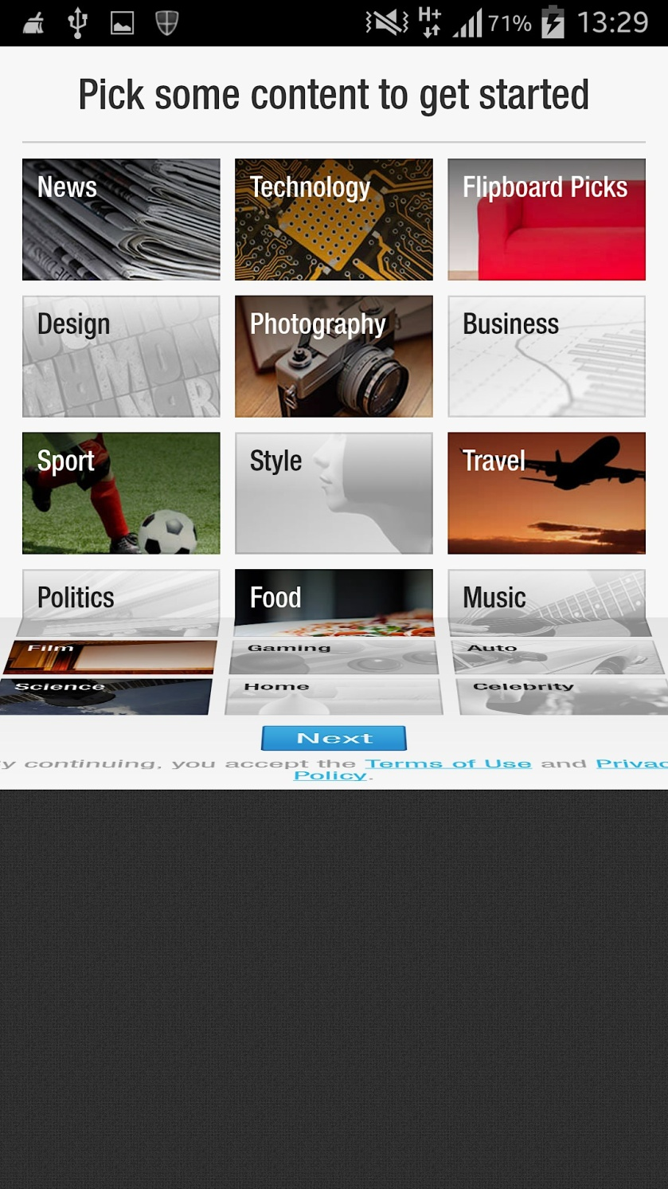
#
INTERFACE (sample)
Style/ Treatment: Flipboard

